Slide 1
User ID Linkage

Slide 2
Problem Statement
Many people participate in multiple social networks (SN) to enjoy their services
Connecting such profiles across SN can potentially improve recommendations and link-predictions

Slide 3
Why do User ID Linkage
User attributes are often incomplete in social networks
But with participation across many social networks, they can form a richer/denser attributes
User attributes are generally noisy and biased across platforms
Eg, Users on Twitter may be related politicial like-minded people
But their Instagram profiles may be related to travel influencers

Slide 4
A sample List of Tables currently used in DC
Sizmek Cookie – Activity Table
Zync Cookie – Activity Table
Disqus Cookie – Activity Table
Cookie – Cookie Mapping Table
Cookie – Email Mapping Table
Email – Email Mapping Table

Slide 5
COOKIE | COOKIE
Cookie_zync_shubh_1 | Cookie_disqus_shubh_1
Cookie_zync_shubh_1 | Cookie_disqus_shubh_2
Identity Map:
Cookie_zync_shubh_1 Cookie_disqus_shubh_1
Cookie_disqus_shubh_2

Slide 6
COOKIE | COOKIE
Cookie_zync_shubh_1 | Cookie_disqus_shubh_1
Cookie_zync_shubh_1 | Cookie_disqus_shubh_2
EMAIL | EMAIL
Email_shubh_1 | Cookie_zync_shubh_1
Identity Map:
Email_shubh_1 Cookie_zync_shubh_1 Cookie_disqus_shubh_1
Cookie_disqus_shubh_2

Slide 7
COOKIE | COOKIE
Cookie_zync_shubh_1 | Cookie_disqus_shubh_1
Cookie_zync_shubh_1 | Cookie_disqus_shubh_2
Cookie_zync_shubh_2 | Cookie_disqus_danny_1
EMAIL | EMAIL
Email_shubh_1 | Cookie_zync_shubh_1
Identity Map:
Email_shubh_1 Cookie_zync_shubh_1 Cookie_disqus_shubh_1
Cookie_disqus_shubh_2
Cookie_zync_shubh_2
Cookie_disqus_danny_1

Slide 8
COOKIE | COOKIE
Cookie_zync_danny_1 | Cookie_disqus_danny_1
Cookie_zync_shubh_1 | Cookie_disqus_shubh_1
Cookie_zync_shubh_1 | Cookie_disqus_shubh_2
Cookie_zync_shubh_2 | Cookie_disqus_danny_1
Identity Map:
Email_shubh_1 Cookie_zync_shubh_1 Cookie_disqus_shubh_1
Cookie_disqus_shubh_2
Cookie_zync_shubh_2
Cookie_disqus_danny_1
Cookie_zync_danny_1
EMAIL | EMAIL
Email_shubh_1 | Cookie_zync_shubh_1

Slide 9
COOKIE | COOKIE
Cookie_zync_danny_1 | Cookie_disqus_danny’s_family_1
Cookie_zync_danny_1 | Cookie_disqus_danny_1
Cookie_zync_shubh_1 | Cookie_disqus_shubh_1
Cookie_zync_shubh_1 | Cookie_disqus_shubh_2
Cookie_zync_shubh_2 | Cookie_disqus_danny_1
Identity Map:
Email_shubh_1 Cookie_zync_shubh_1 Cookie_disqus_shubh_1
Cookie_disqus_shubh_2
Cookie_zync_shubh_2
Cookie_disqus_danny_1
Cookie_zync_danny_1
Cookie_disqus_danny_f_1
EMAIL | EMAIL
Email_shubh_1 | Cookie_zync_shubh_1

Slide 10
Coming to the paper
Graph Neural Networks for User Identity Linkage, by Zhang, et.al. [arxiv, 2019]
Authors propose to Use Graph Neural Networks, with few additions over the baseline approach of using Node2Vec/GNNs
Named their approach: GraphUIL (Graph + UIL→ User ID Linkage)

Slide 11
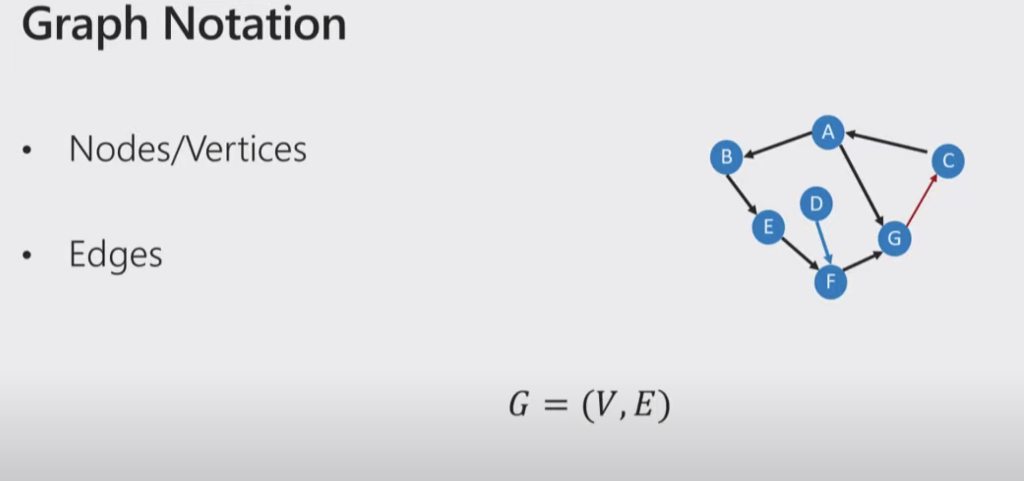
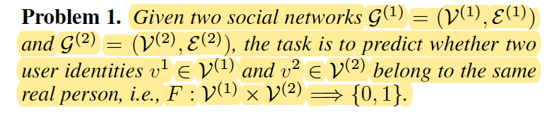
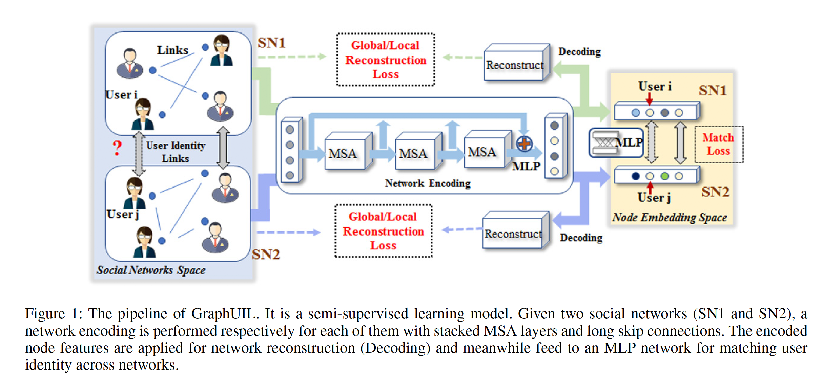

Slide 14
Intro to GNN
Graphs in Adjacent Matrix Form (i.e., One hot encoded Nodes)
Input features (initially random, a hyperparameter for embedding size)
Output features (a hyperparameter for embedding size, can be of diff. size from input)
Forward Pass:
Trigger “Message passing” on all edges
Trigger “Aggregration” at all nodes
Get resulting “Node Features”
Perform “Linear Transformation”

Slide 15
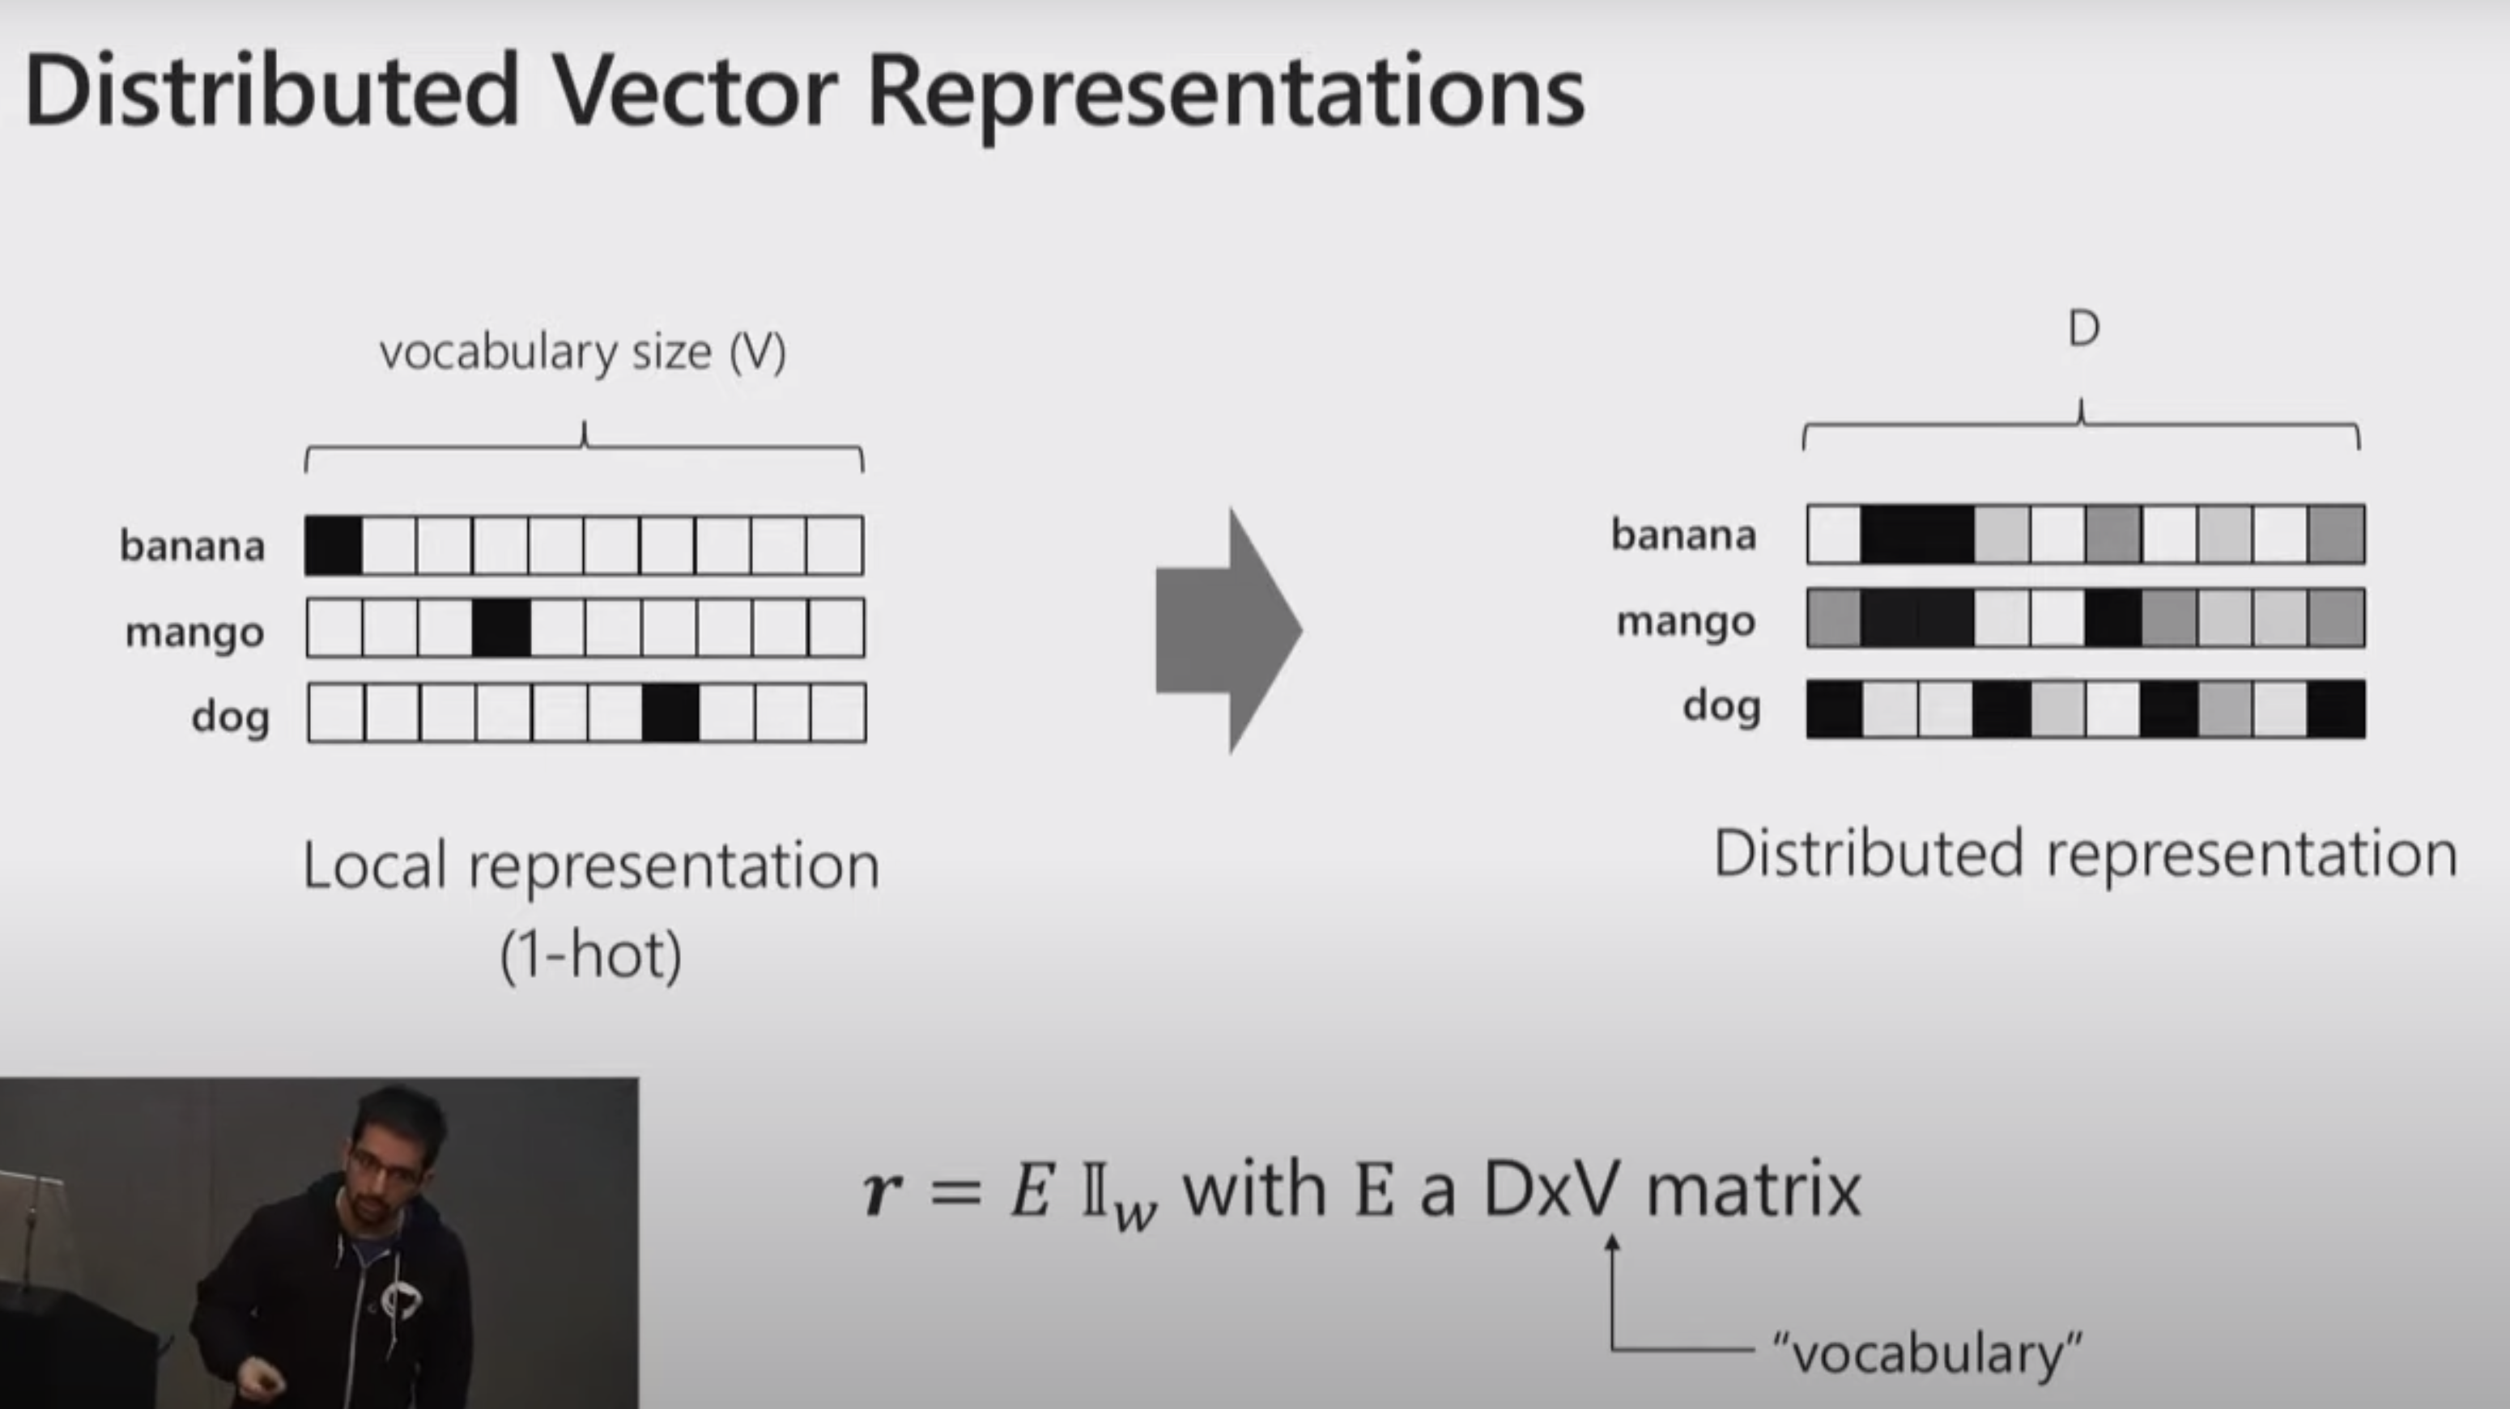
What GNN are trying to achieve

Slide 16
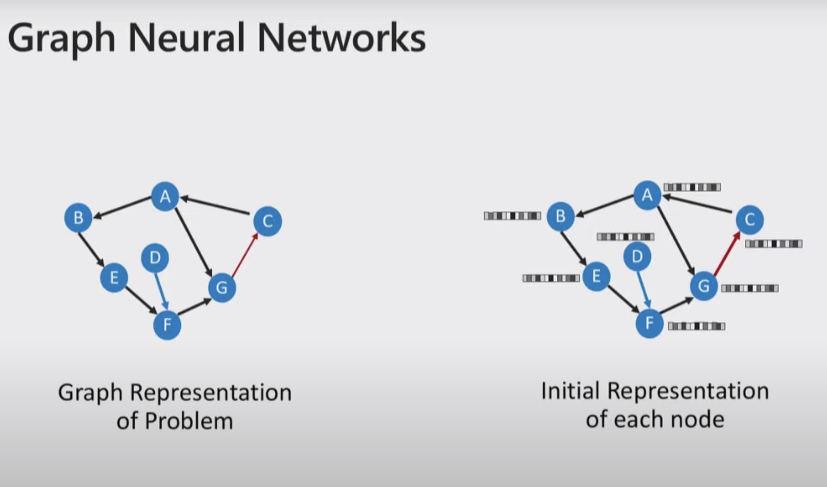

Slide 17
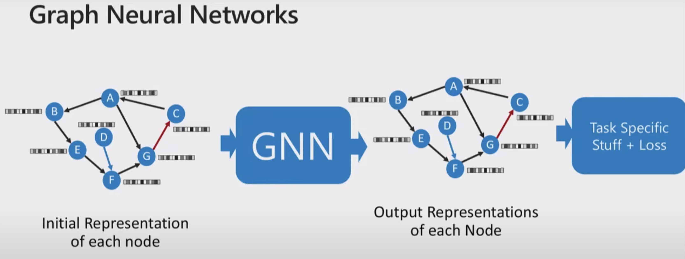

Slide 18
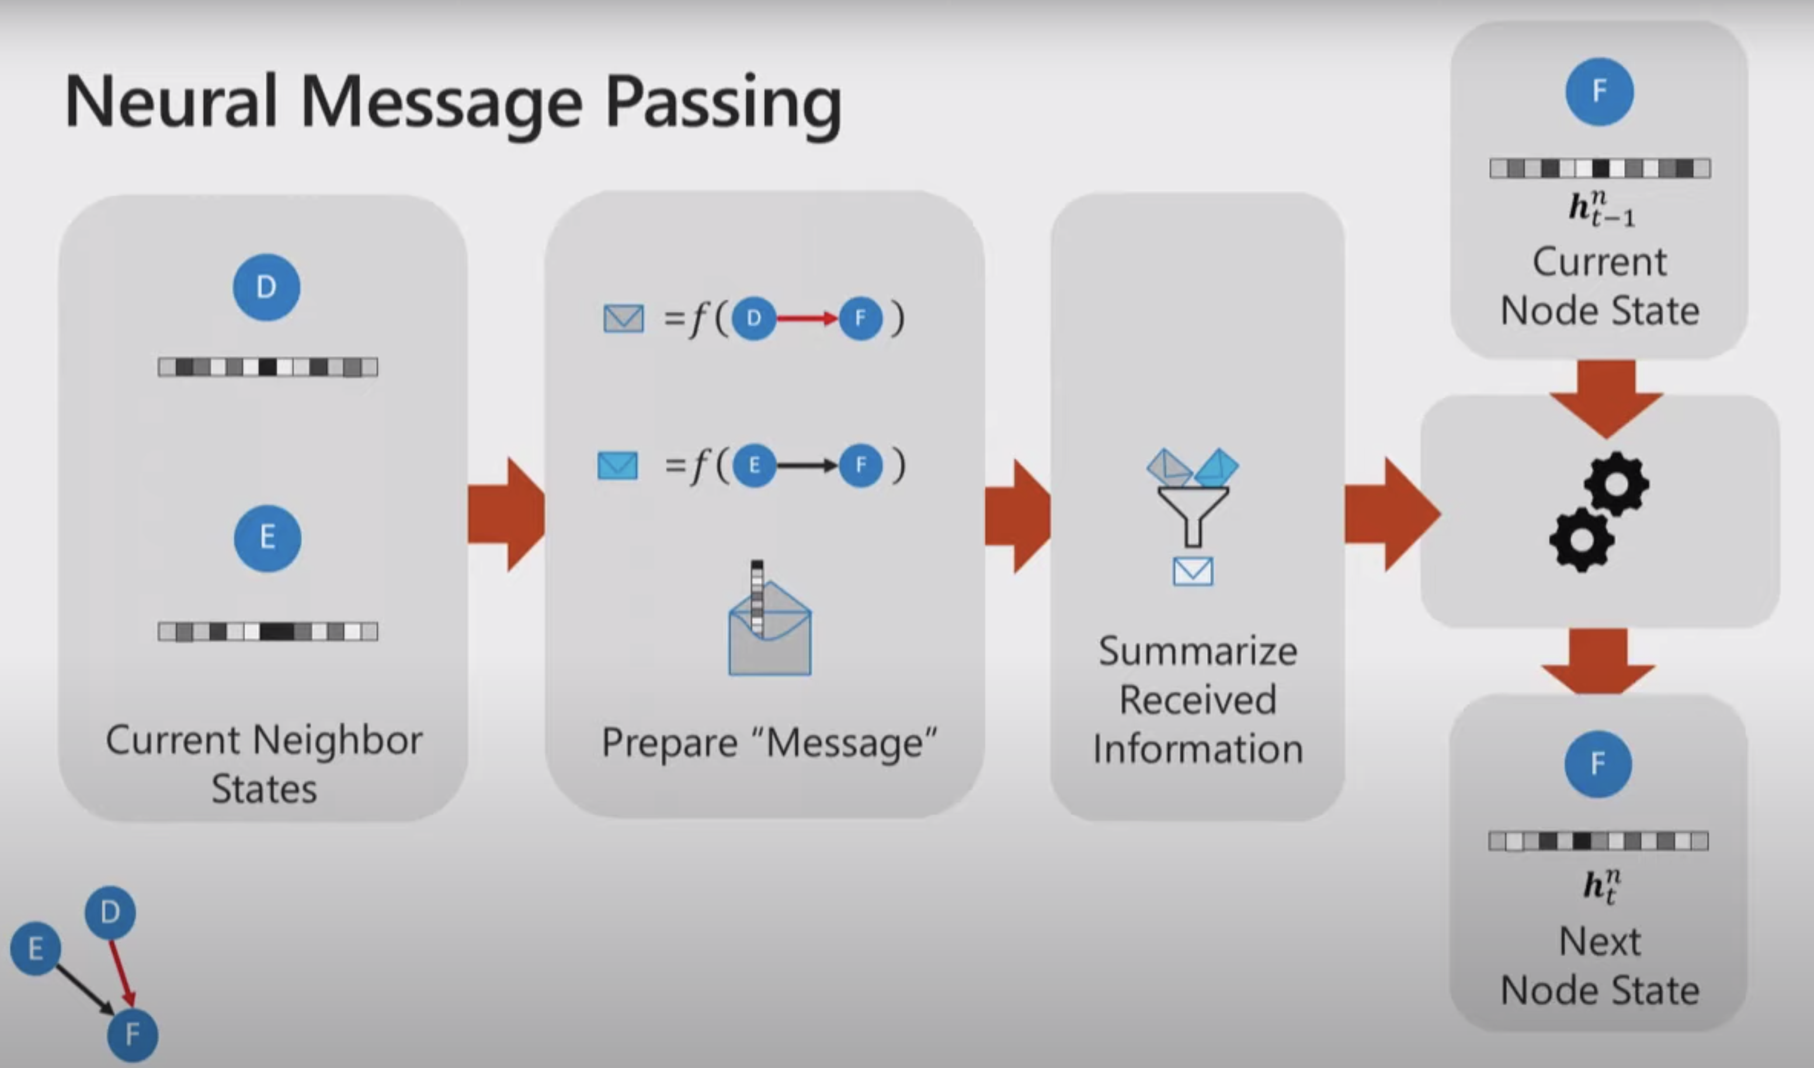

Slide 19
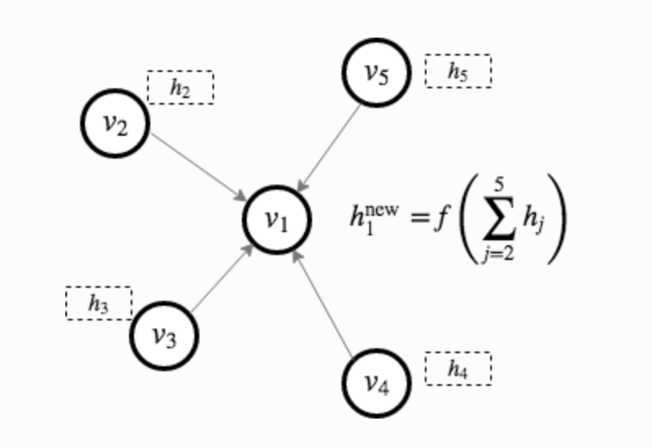
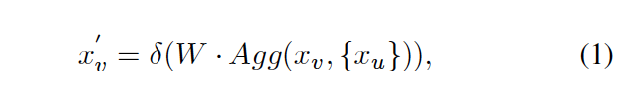
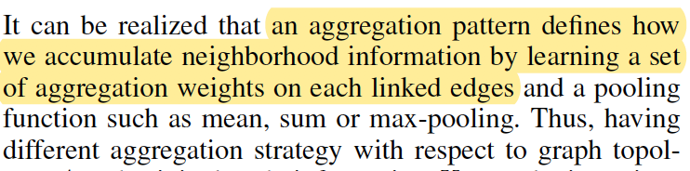
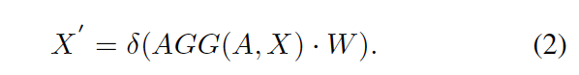

Slide 20
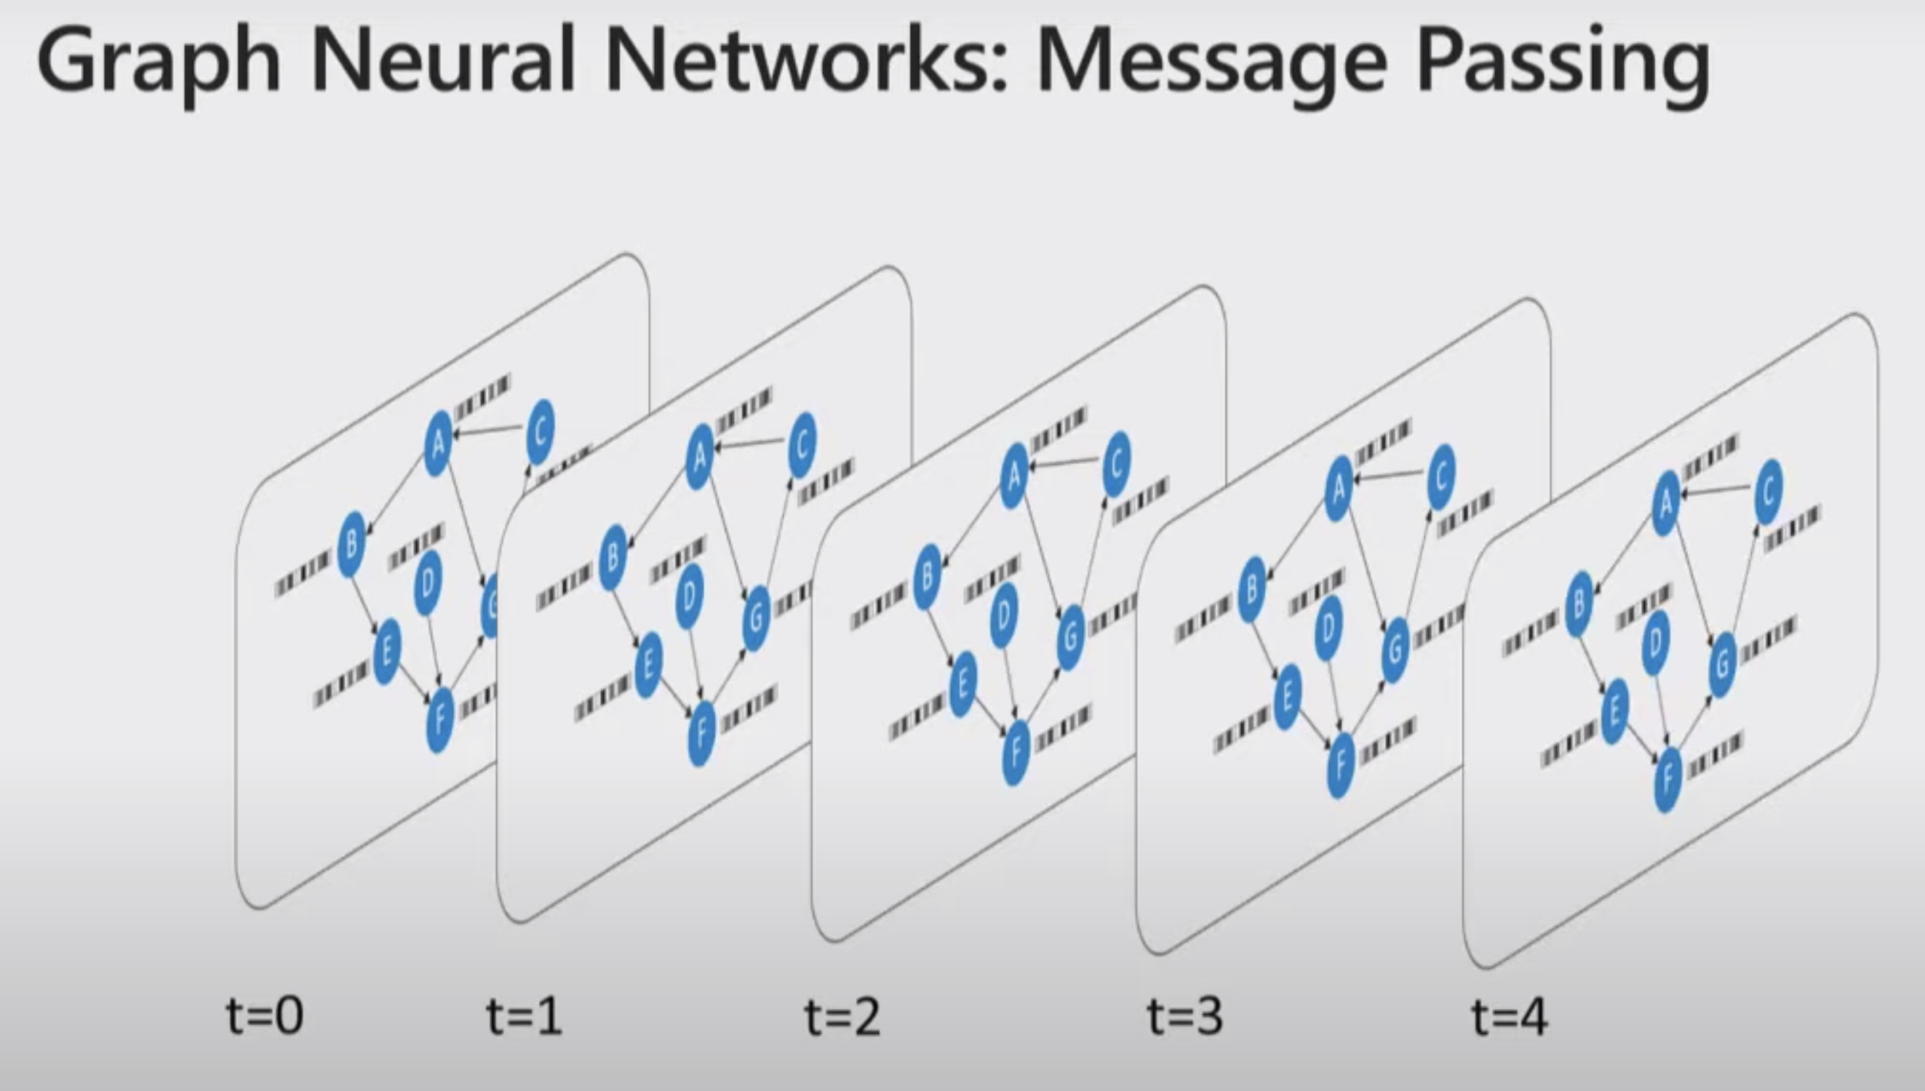

Slide 21
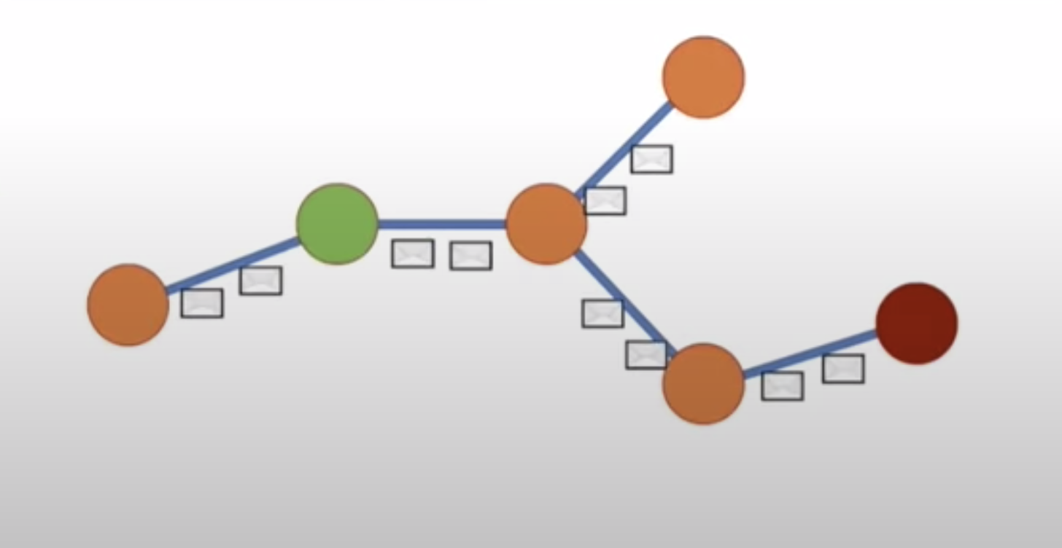

Slide 22
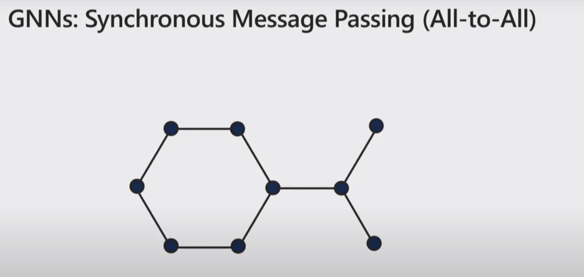

Slide 23
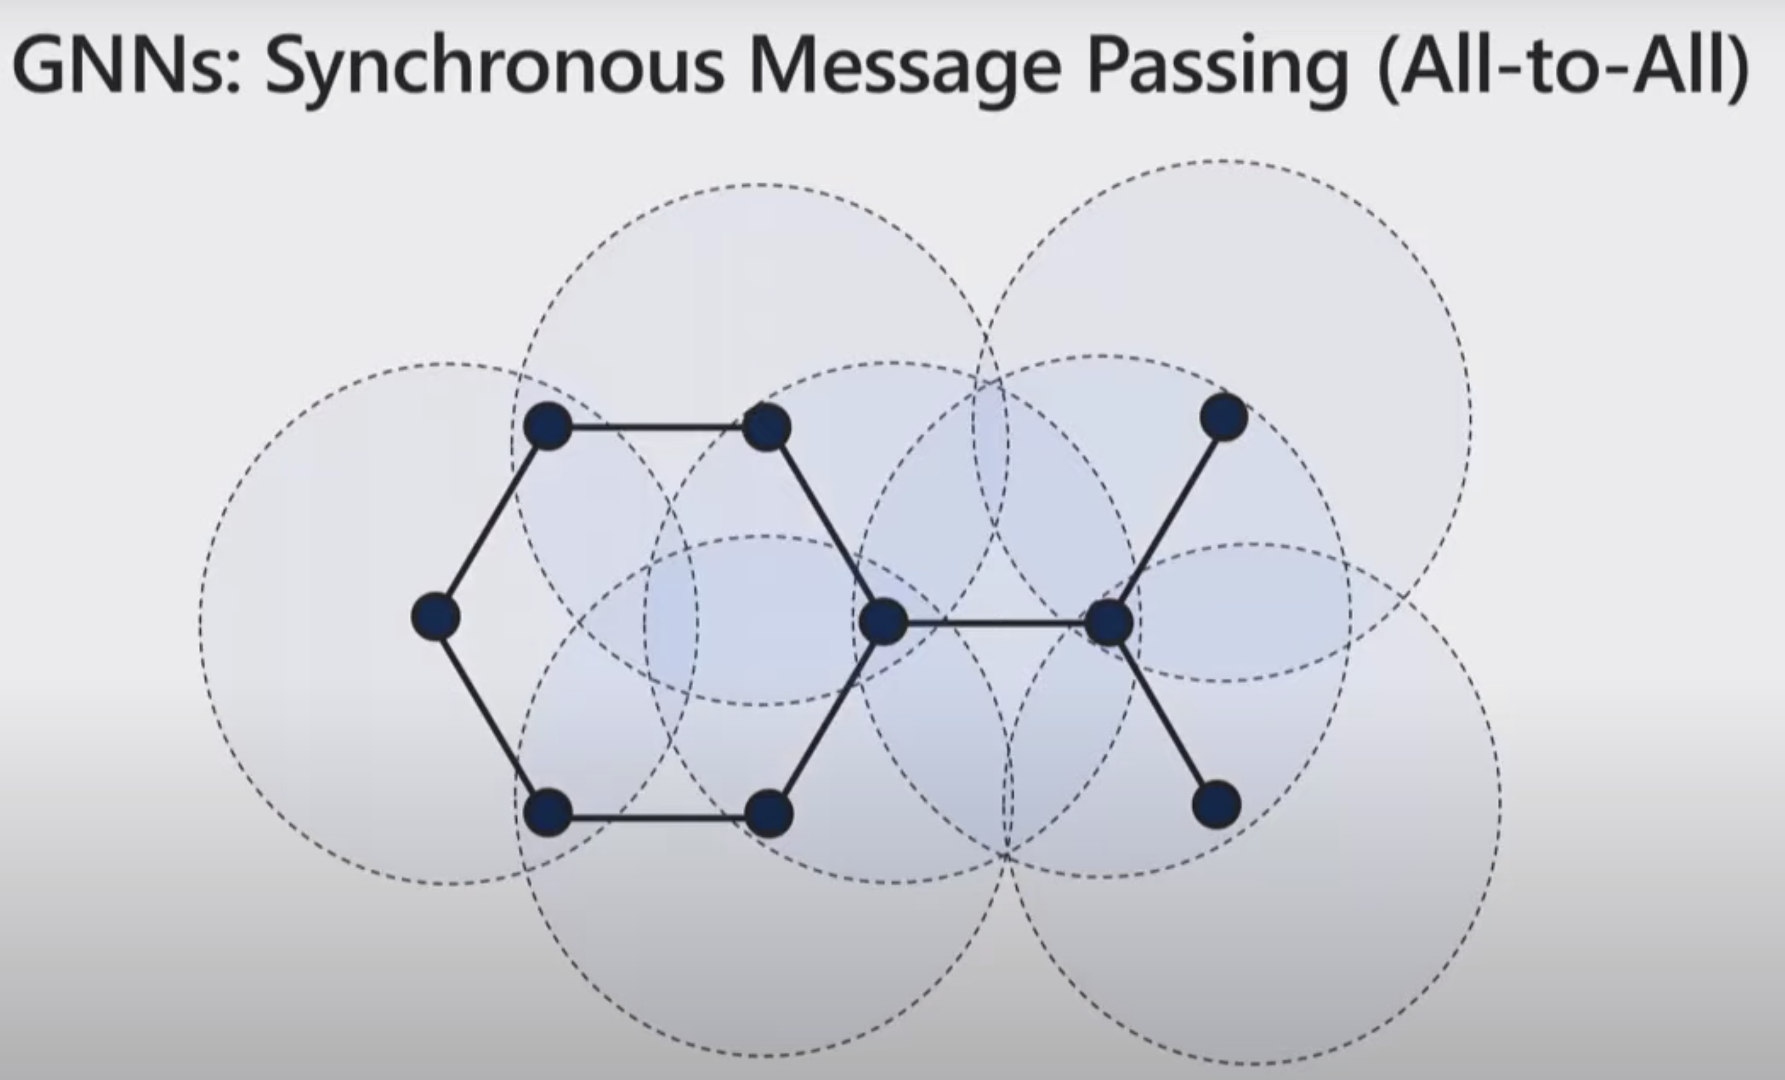

Slide 24
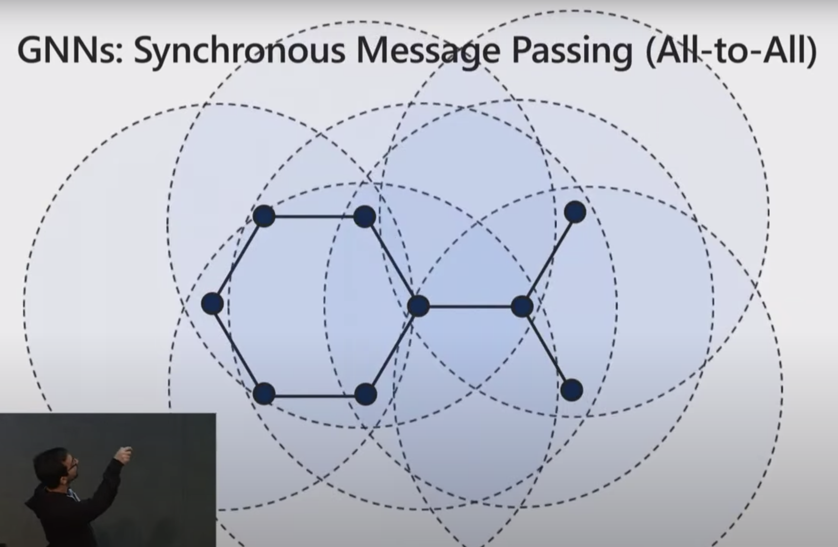

Slide 25
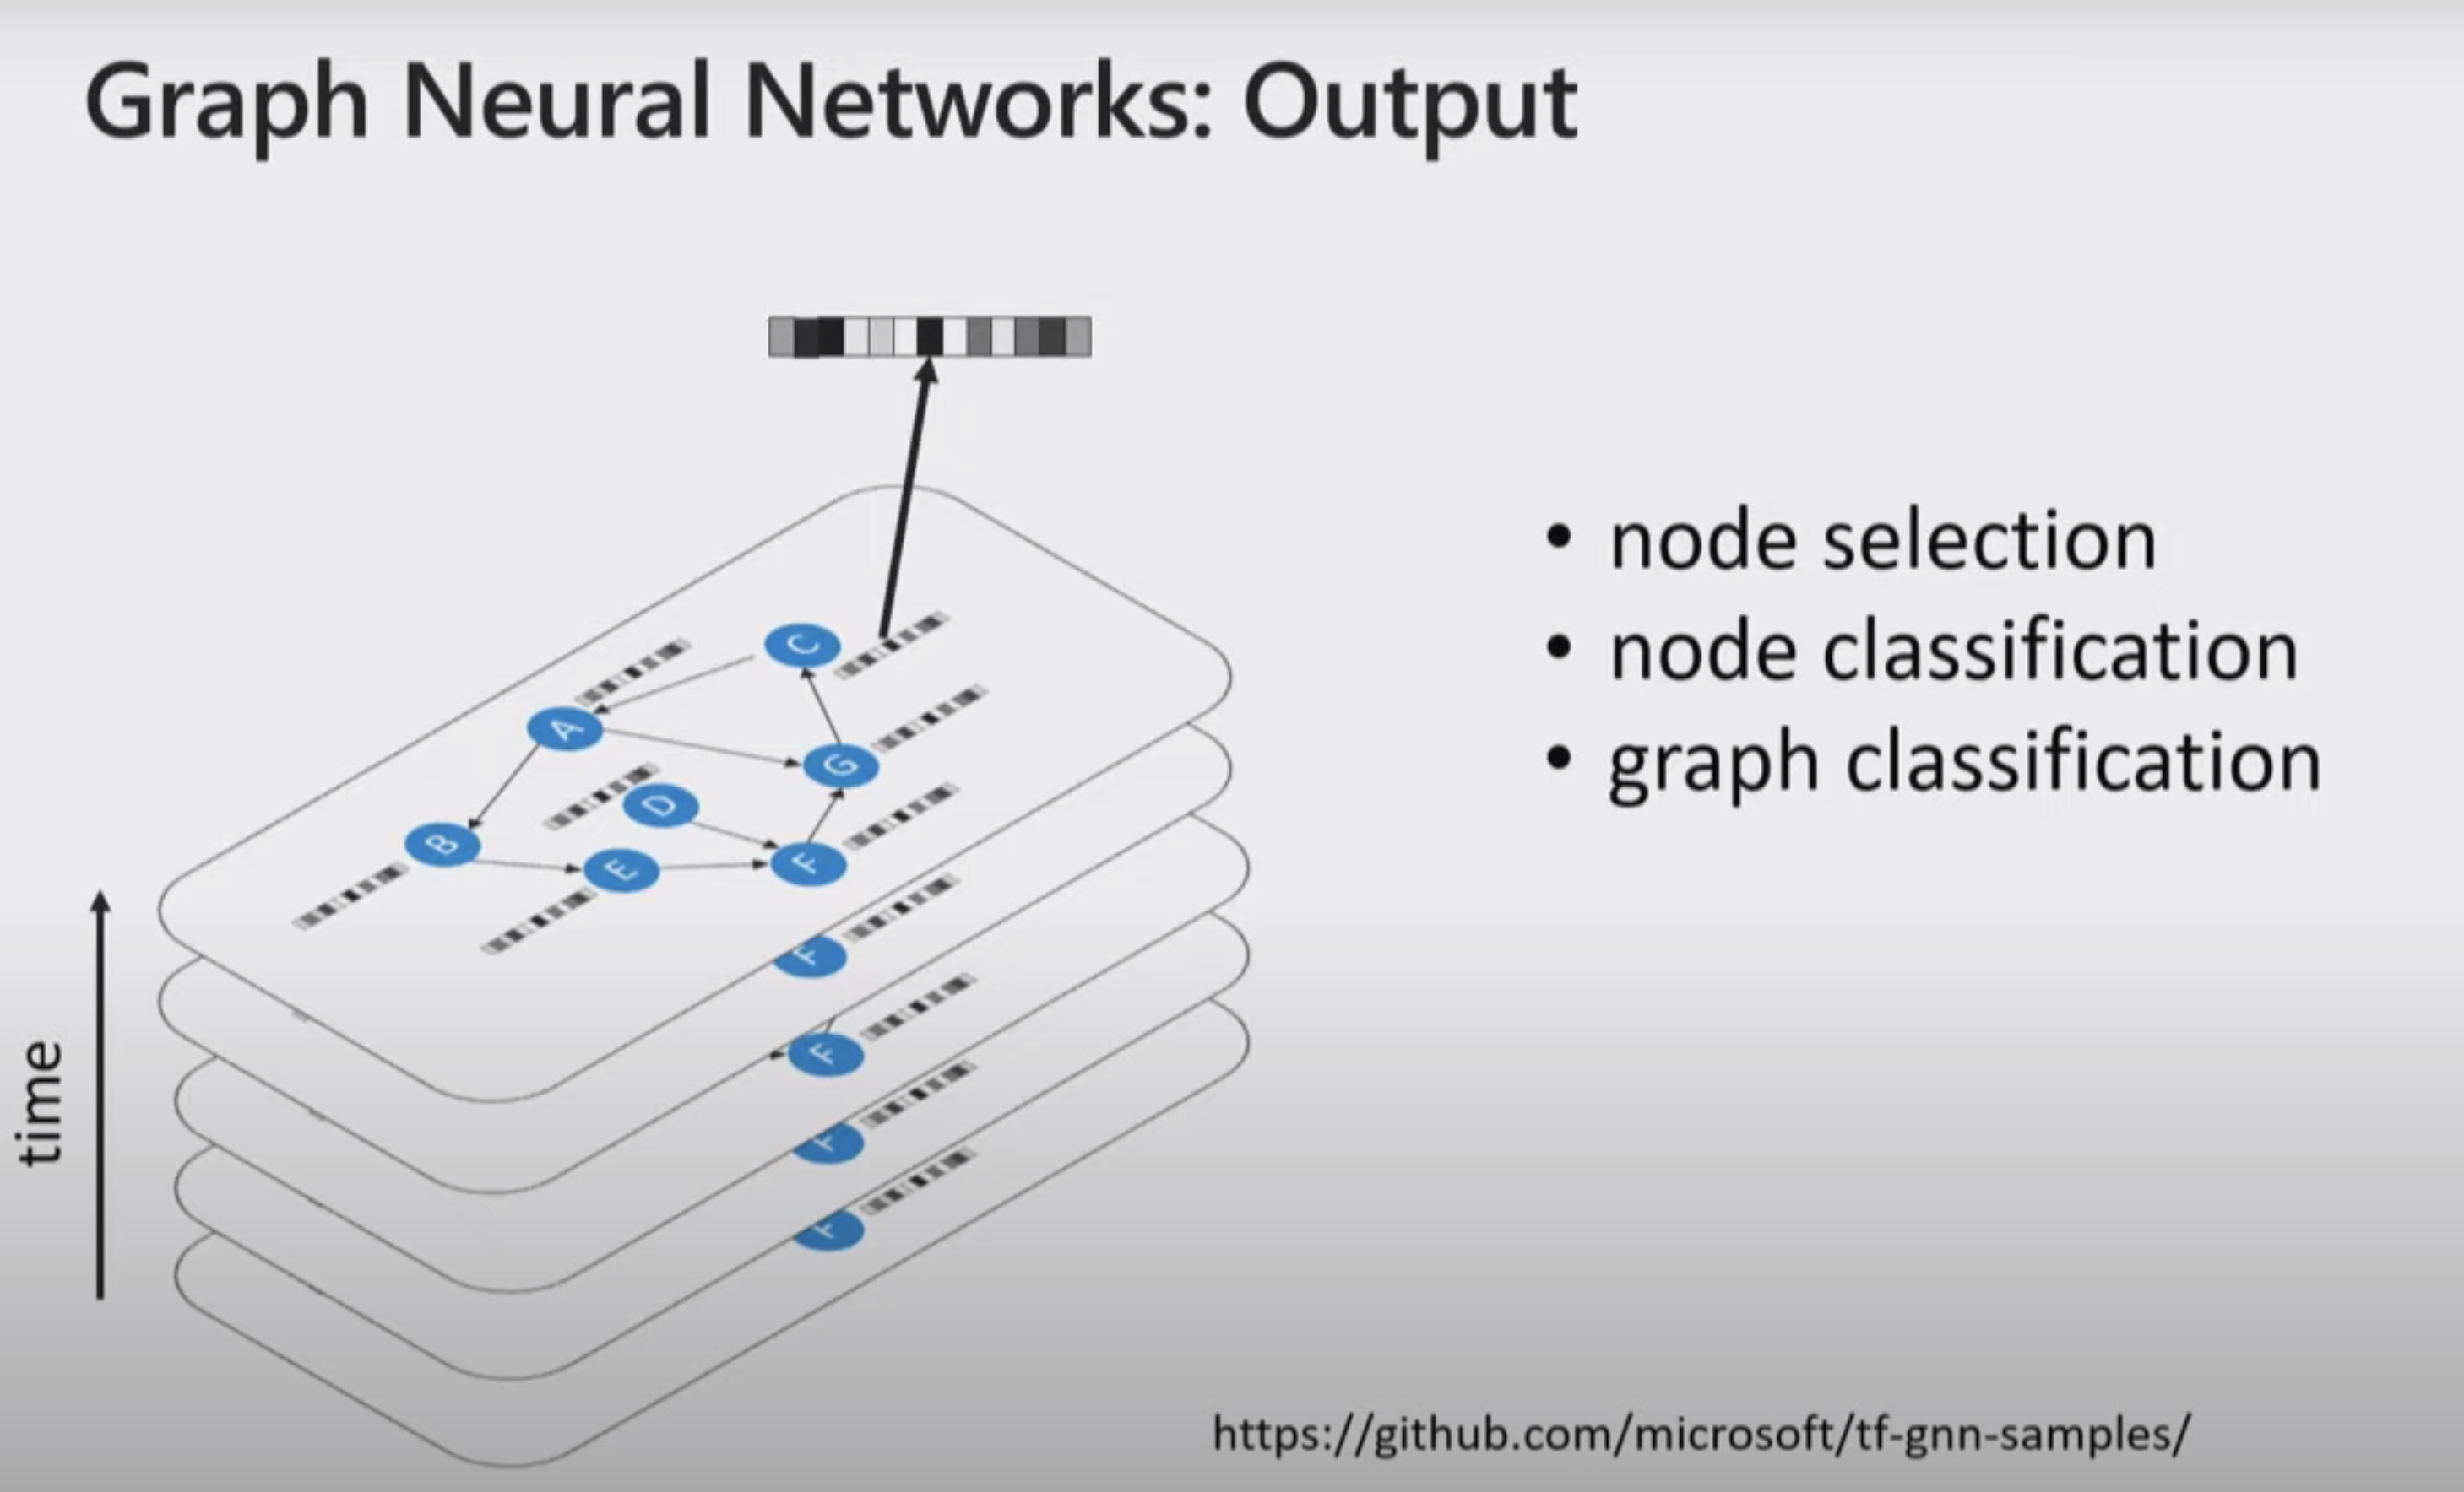

Slide 29
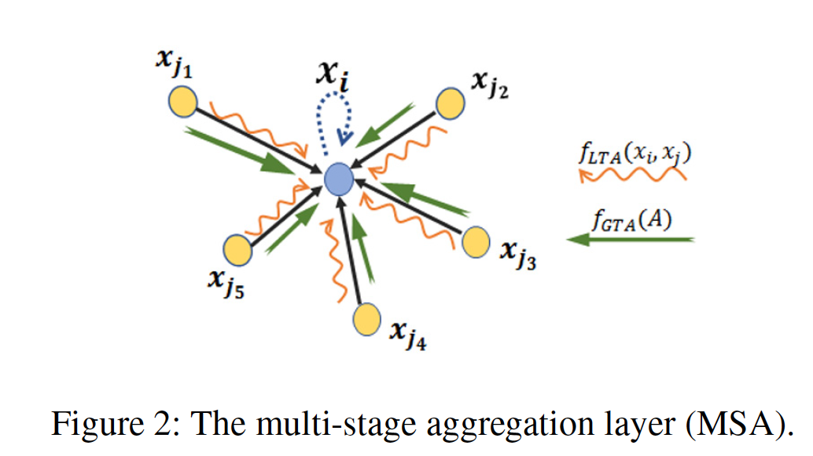

Slide 30
ssss
aaaa
bbb
 | 1 | 1
1
1

Slide 31
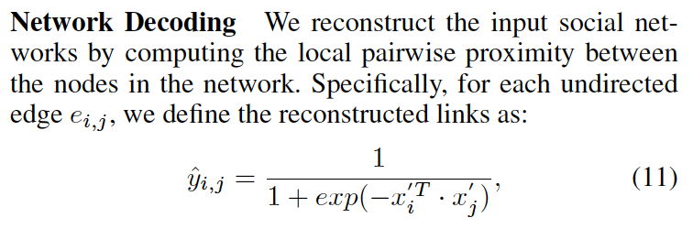
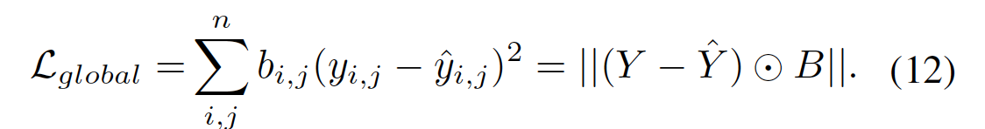
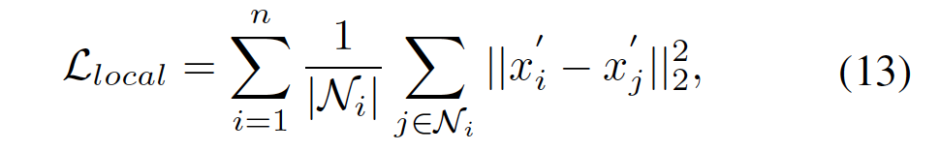
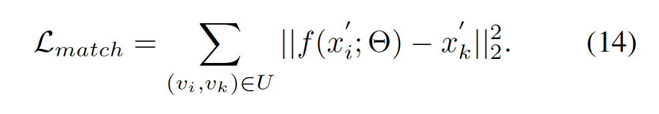
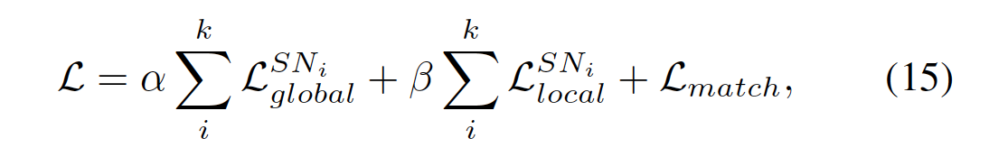

Slide 32
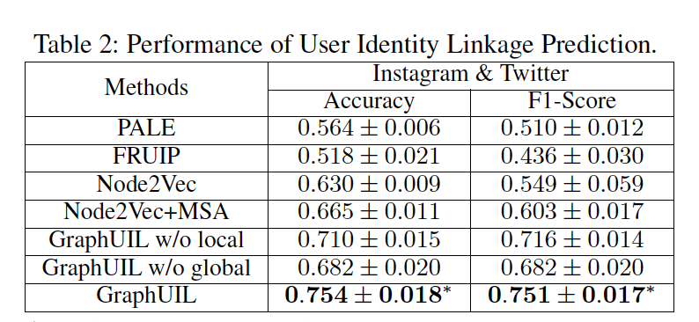
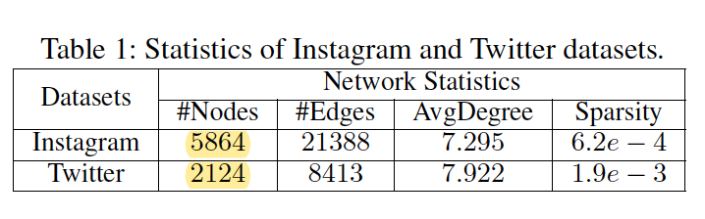
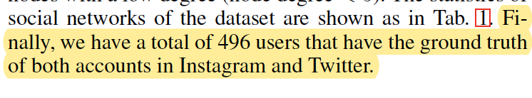

Slide 33
APPENDIX
Paper Presented: https://arxiv.org/abs/1903.02174
YouTube talk on Graph Neural Networks
https://www.youtube.com/watch?v=zCEYiCxrL_0

Slide 35
Graph Adjacent Matrix -> MSA -> … -> MSA -> Encoded Graph Topology
It encodes the nodes (which are one hot encoded, aka adjacent matrix) into “node embeddings”

